Slide 1

Massagerx massage recommendation program

Slide 2

Major components
Mysql database
Python scoring logic
Flask & mysql connector

Slide 3

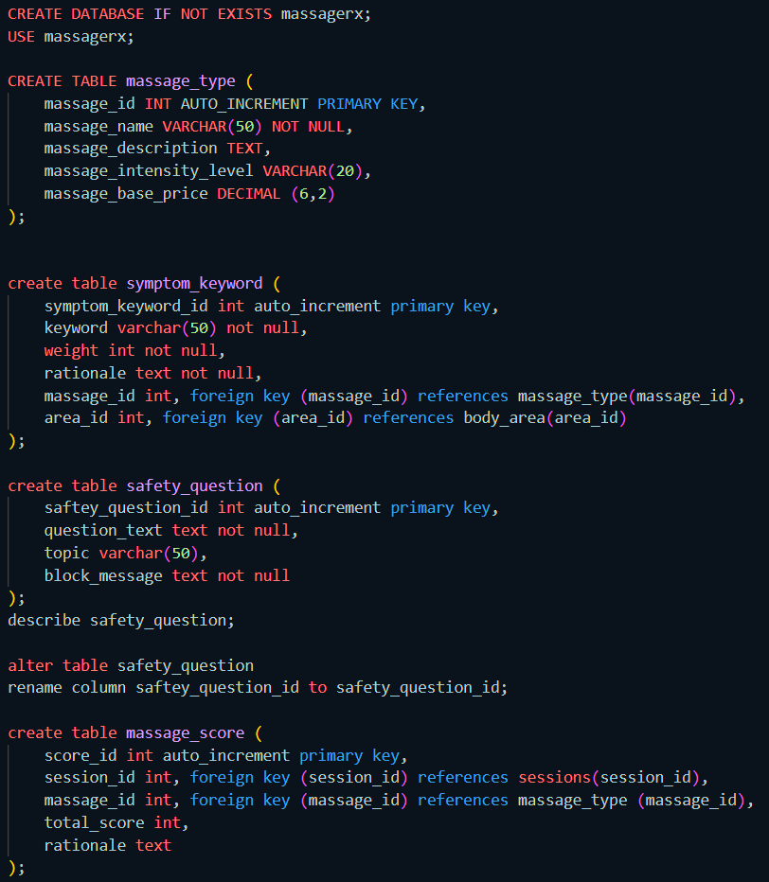
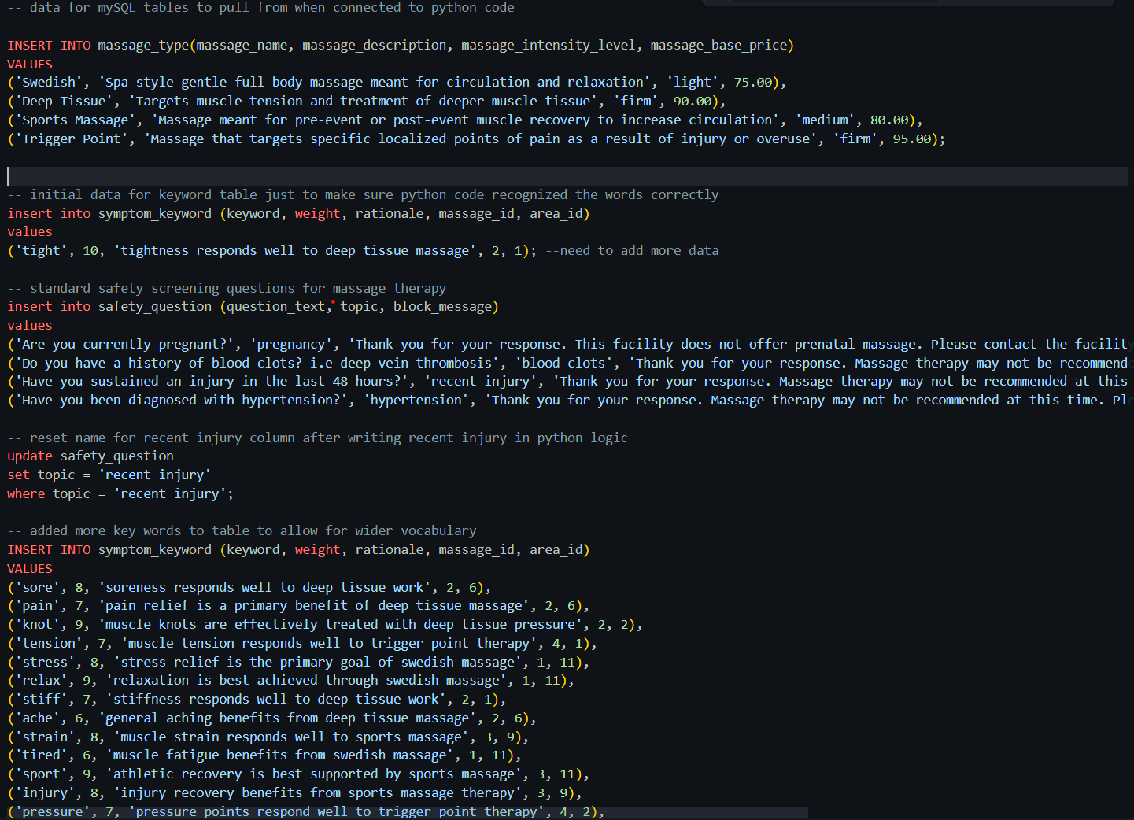
Mysql database

Slide 4
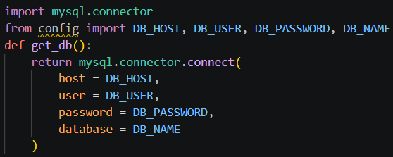
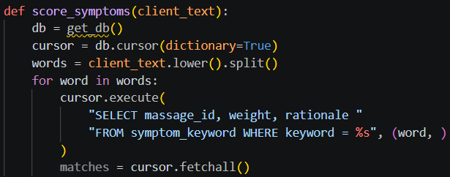
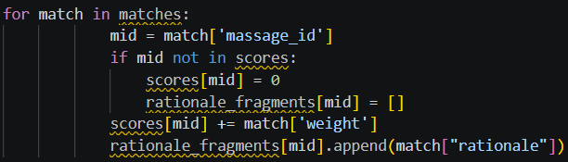
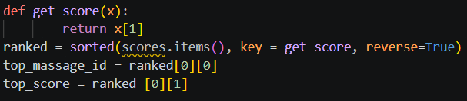
Scoring logic highlights
MySQL Connection Function
Client Text Manipulation
Tallying Score for Each Massage Type
Determine Highest Ranked Massage Type

Slide 5
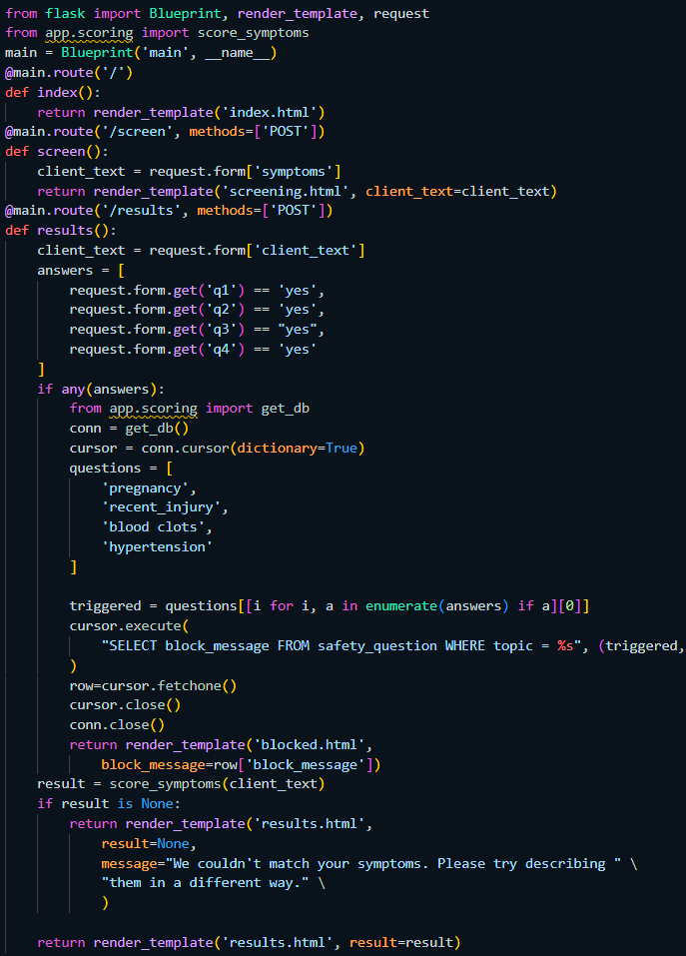
Flask highlights
IMPORT THREE VITAL COMPONENTS FROM FLASK TOOL
IMPORT SCORE_SYMPTOMS VARIABLE FROM SCORING LOGIC
@MAIN.ROUTE(‘…‘)
SEQUENCE MATTERS IN FLASK CODE … CHECK SCREENING ANSWERS FIRST THEN IF THE CLIENT “PASSES” THE SCREENING SHOW RECOMMENDATION

Slide 6
OTHER COMPONENTS OF THE PROGRAM
FUTURE COMPONENTS
- ADD-ON SERVICES WITH PRICING (CUPPING, CBD OIL, STRETCHING)
- SESSION HISTORY — TRACK PAST RECOMMENDATIONS PER CLIENT
- EXPANDED KEYWORD LIBRARY FOR BROADER SYMPTOM COVERAGE
- ADMIN DASHBOARD SHOWING KEYWORD WEIGHTS AND SCORING BREAKDOWN
HTML TEMPLATES – LEARNING CURVE WAS STEEP AI ASSISTED WITH PREMADE RENDERING TEMPLATES
CSS – AESTHETICS FOR THE WEB PAGE

Slide 7

THANK YOU
JASMIN MONROE
MS HEALTHCARE MANAGEMENT AND INFORMATICS

